Slide 1
Introgression analysis of Syngenta NILs via GBS sequencing: CML228
JMKolkman

Slide 2
CML228 NIL Introgressions (based on Syngenta data provided at time of seed acquisition)
row_id | row_name | experiment_id | pedigree | LG | Region | Non_targeted Regions
10NN0057 | 57 | 10NN | CML228/B73 NIL-1006 | 1 | Region: 140-160 | H(8:5.09cM) H(8: OcM) H(2: 10.2cM)
10NN0059 | 59 | 10NN | CML228/B73 NIL-1023 | 2 | Region: 10-20 | B(2: 5.74cM) H(l: 73.43cM)
10NN0061 | 61 | 10NN | CML228/B73 NIL-1028 | 1 | Region: 100-120 | B(l: 99.58cM)
10NN0063 | 63 | 10NN | CML228/B73 NIL-1038 | 1 | Region: 160-180 | H(4: 57.28cM) H(2:10.2cM)
10NN0065 | 65 | 10NN | CML228/B73 NIL-1041 | 4 | Region: 50-60 | B(4:48.49cM) B(4:45.82cM)
10NN0067 | 67 | 10NN | CML228/B73 NIL-1045 | 6 | Region: 30-40 | H(5:79.14cM)
10NN0069 | 69 | 10NN | CML228/B73 NIL-1049 | 3 | Region: 60-70 | None
10NN0071 | 71 | 10NN | CML228/B73 NIL-1068 | 4 | Region: 70-80 | B(4: 65.34cM) B(4: 65.25cM)
10NN0073 | 73 | 10NN | CML228/B73 NIL-1077 | 3 | Region: 110-120 | H(3: 33.54cM)
10NN0075 | 75 | 10NN | CML228/B73 NIL-1085 | 3 | Region: 30-40 | None
10NN0077 | 77 | 10NN | CML228/B73 NIL-1087 | 7 | Region: 60-70 | B(3:113.05cM)
10NN0079 | 79 | 10NN | CML228/B73 NIL-1102 | 1 | Region: 20-40 | None
10NN0081 | 81 | 10NN | CML228/B73 NIL-1110 | 8 | Region: 50-60 | B(8: 63.71cM)
10NN0083 | 83 | 10NN | CML228/B73 NIL-1110 | 8 | Region: 60-70 | B(8: 56.12CM) B(8:57.28cM)
10NN0085 | 85 | 10NN | CML228/B73 NIL-1118 | 1 | Region: 40-60 | None
10NN0087 | 87 | 10NN | CML228/B73 NIL-1128 | 7 | Region: 110-120 | H(l: 47.46cM)
10NN0089 | 89 | 10NN | CML228/B73 NIL-1134 | 3 | Region: 50-60 | H(5: OcM) B(l: 28.57cM) B(l: 24.09cM)
10NN0091 | 91 | 10NN | CML228/B73 NIL-1142 | 5 | Region: 50-60 | H(5: 82.47cM)
10NN0093 | 93 | 10NN | CML228/B73 NIL-1143 | 5 | Region: 80-90 | None
10NN0095 | 95 | 10NN | CML228/B73 NIL-1179 | 6 | Region: 80-90 | H(10:49.1cM)
10NN0097 | 97 | 10NN | CML228/B73 NIL-1214 | 2 | Region: 90-100 | B(7: 39.47cM)
10NN0099 | 99 | 10NN | CML228/B73 NIL-1215 | 7 | Region: 30-40 | None
10NN0101 | 101 | 10NN | CML228/B73 NIL-1230 | 1 | Region: 80-100 | B(l: 100.29cM) H(8: OcM)
10NN0103 | 103 | 10NN | CML228/B73 NIL-1231 | 1 | Region: 60-80 | None

Slide 3
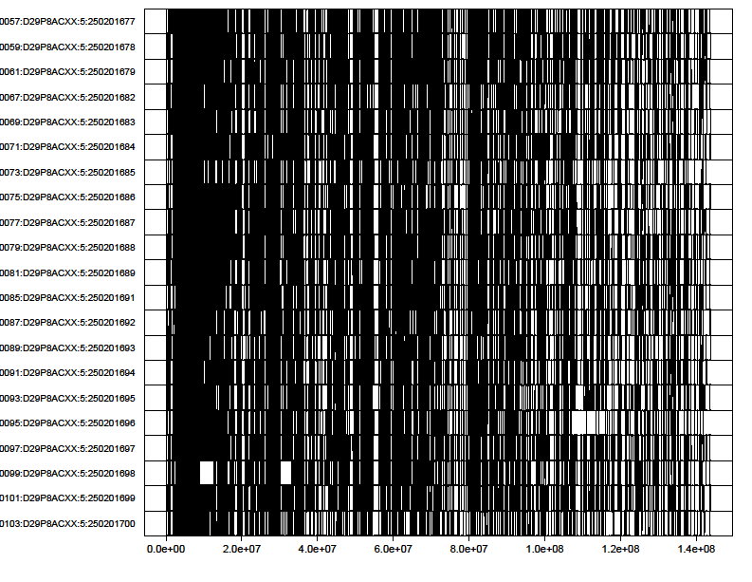
CML228 Introgression on Chromosome 10 based on GBS data
‘l’ = SNP different to B73
‘l’ = SNP different to CML228

Slide 4
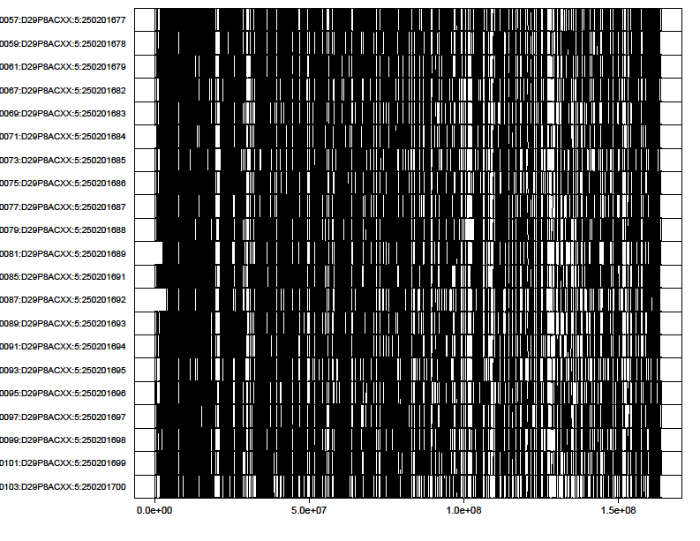
CML228 Introgression on Chromosome 9 based on GBS data
‘l’ = SNP different to B73
‘l’ = SNP different to CML228

Slide 5
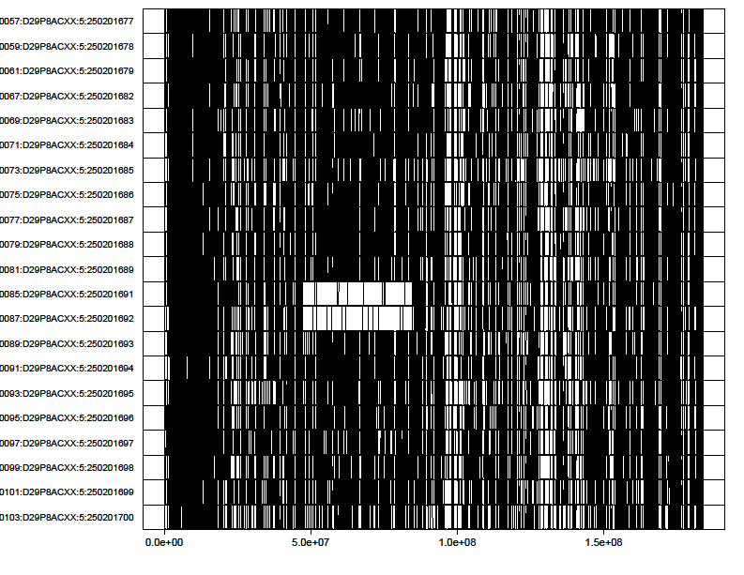
CM228 Introgression on Chromosome 8 based on GBS data
‘l’ = SNP different to B73
‘l’ = SNP different to CML228

Slide 6
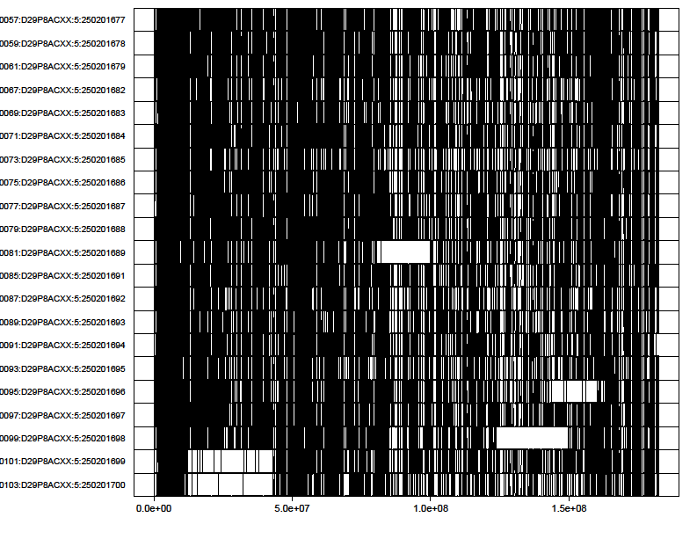
CML228 Introgression on Chromosome 7 based on GBS data
‘l’ = SNP different to B73
‘l’ = SNP different to CML228

Slide 7
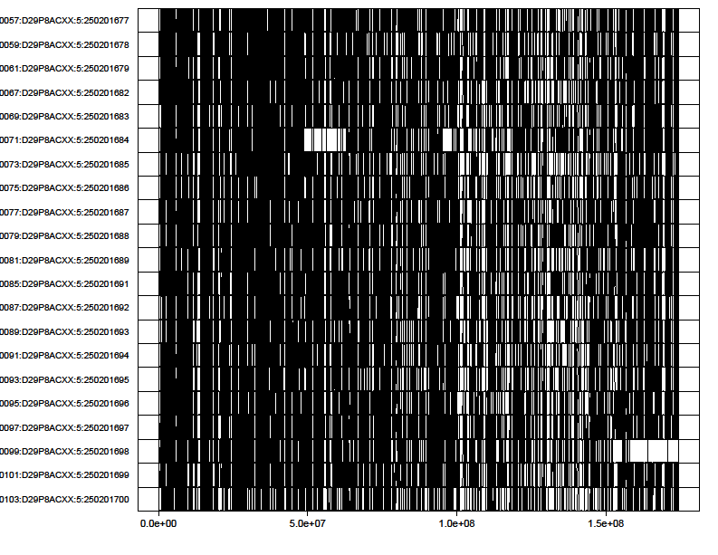
CML228 Introgression on Chromosome 6 based on GBS data
‘l’ = SNP different to B73
‘l’ = SNP different to CML228

Slide 8
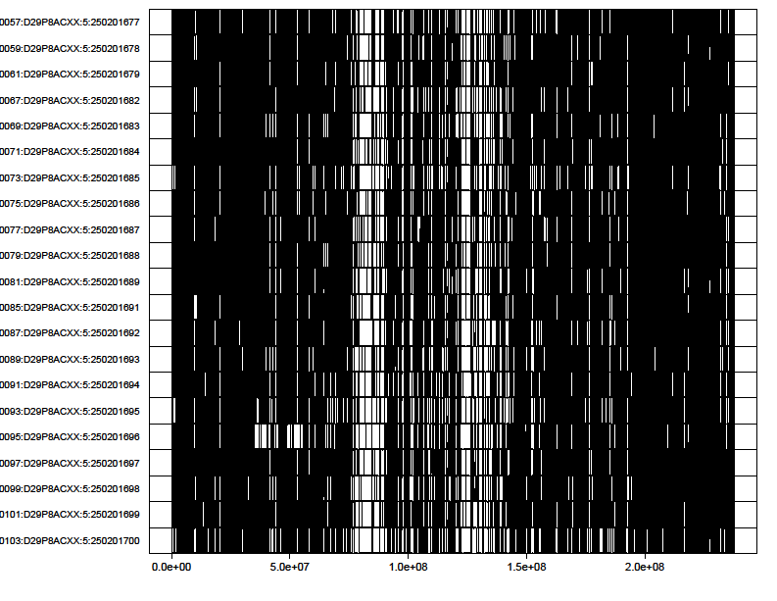
CML228 Introgression on Chromosome 5 based on GBS data
‘l’ = SNP different to B73
‘l’ = SNP different to CML228

Slide 9
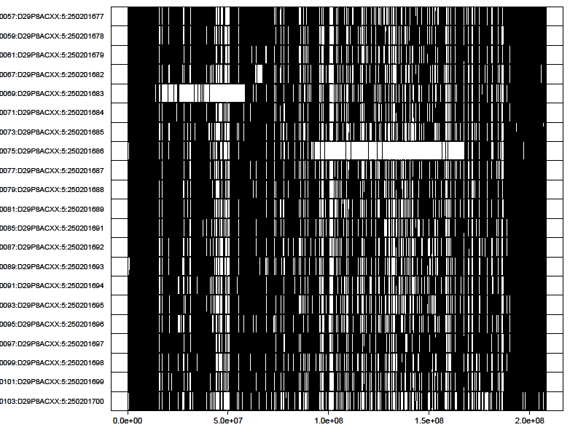
CML228 Introgression on Chromosome 4 based on GBS data
‘l’ = SNP different to B73
‘l’ = SNP different to CML228

Slide 10
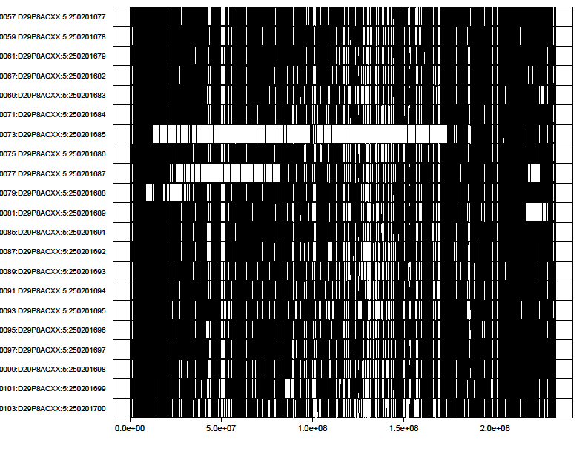
CML228 Introgression on Chromosome 3 based on GBS data
‘l’ = SNP different to B73
‘l’ = SNP different to CML228

Slide 11
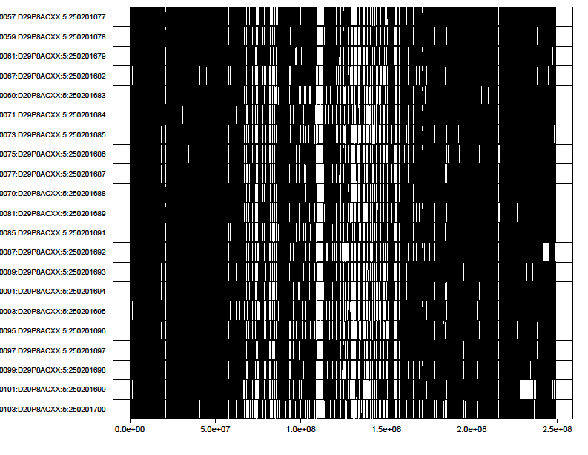
CML228 Introgression on Chromosome 2 based on GBS data
‘l’ = SNP different to B73
‘l’ = SNP different to CML228

Slide 12
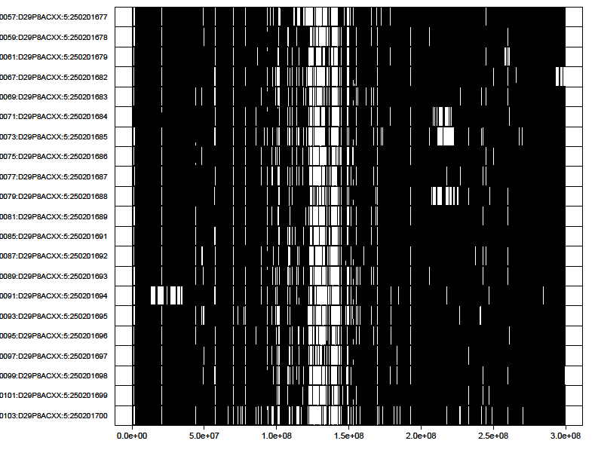
CML228 Introgression on Chromosome 1 based on GBS data
‘l’ = SNP different to B73
‘l’ = SNP different to CML228

Slide 13
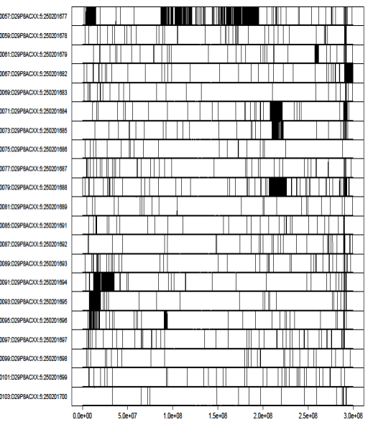
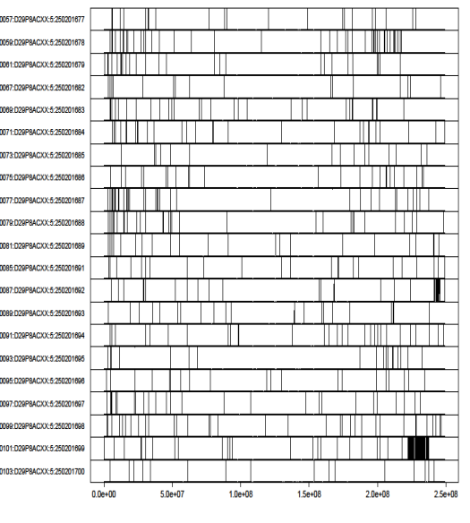
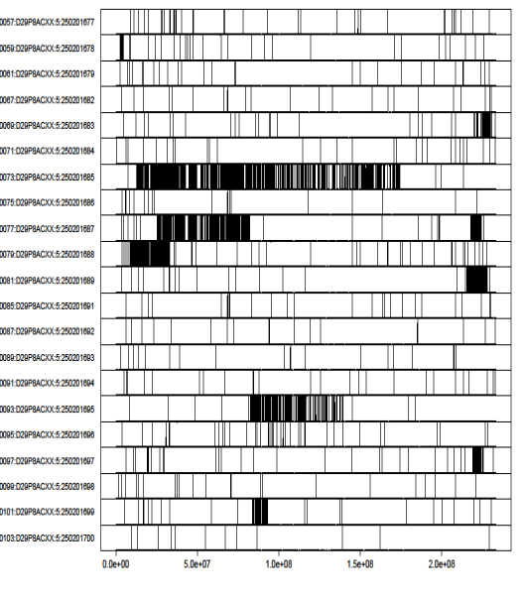
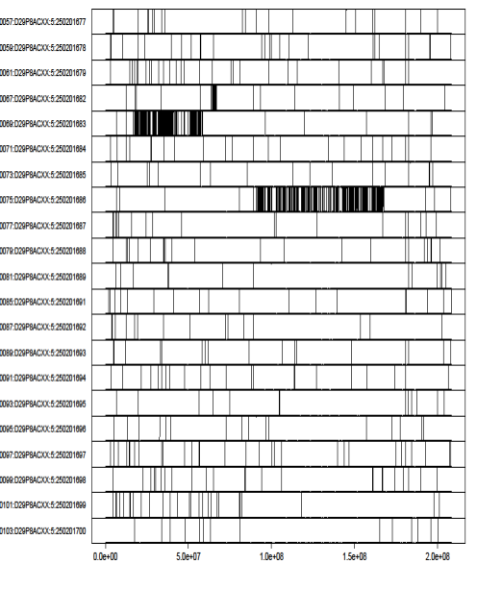
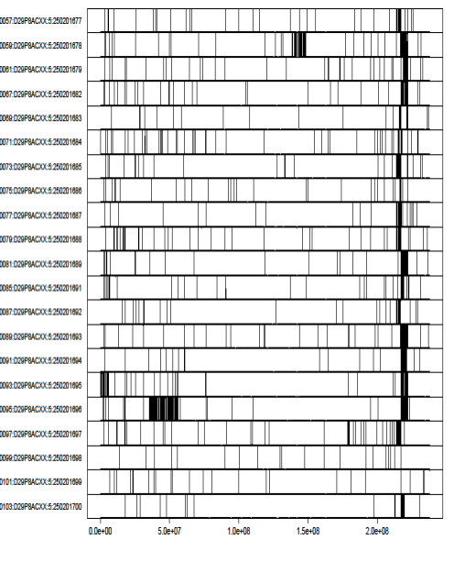
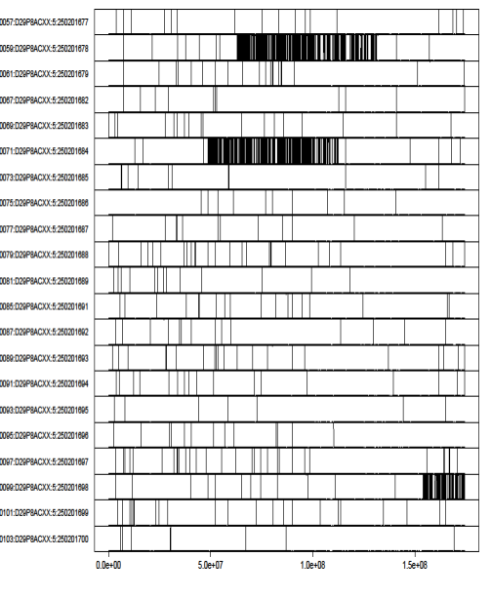
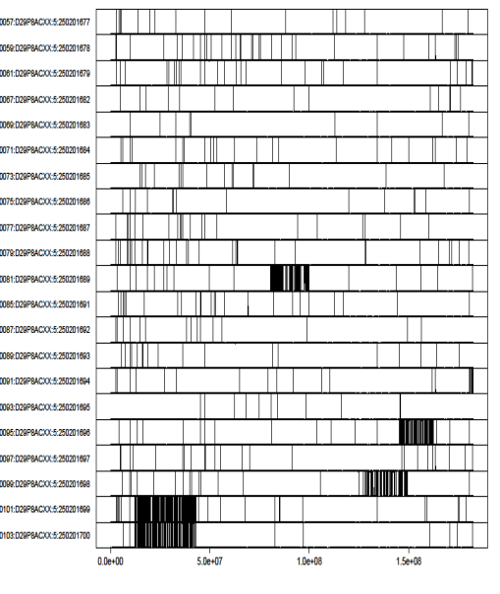
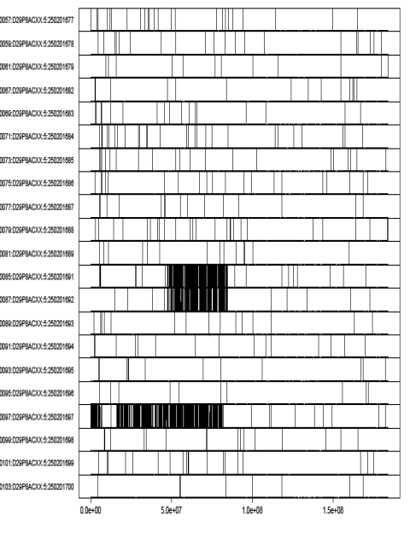
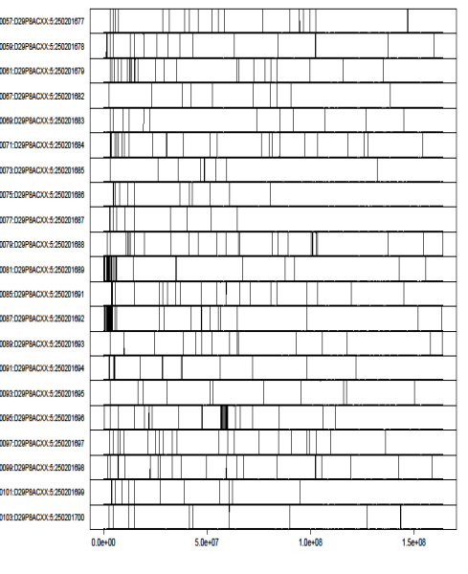
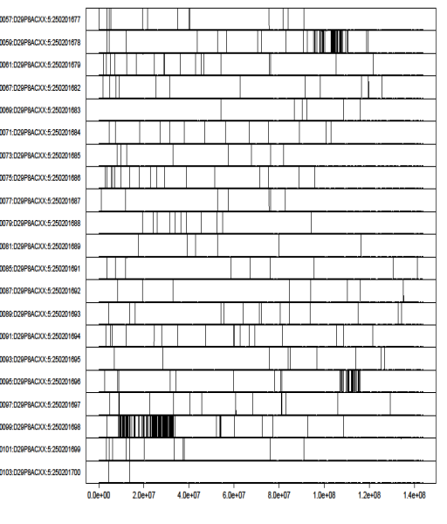
Compilation of CML228 introgressions in B73 Syngenta NILs
1
2
3
4
5
6
7
8
9
10
10NN0057 | CML228/B73 NIL-1006
10NN0059 | CML228/B73 NIL-1023
10NN0061 | CML228/B73 NIL-1028
10NN0067 | CML228/B73 NIL-1045
10NN0069 | CML228/B73 NIL-1049
10NN0071 | CML228/B73 NIL-1068
10NN0073 | CML228/B73 NIL-1077
10NN0075 | CML228/B73 NIL-1085
10NN0077 | CML228/B73 NIL-1087
10NN0079 | CML228/B73 NIL-1102
10NN0081 | CML228/B73 NIL-1110
10NN0085 | CML228/B73 NIL-1118
10NN0087 | CML228/B73 NIL-1128
10NN0089 | CML228/B73 NIL-1134
10NN0091 | CML228/B73 NIL-1142
10NN0093 | CML228/B73 NIL-1143
10NN0095 | CML228/B73 NIL-1179
10NN0097 | CML228/B73 NIL-1214
10NN0099 | CML228/B73 NIL-1215
10NN0101 | CML228/B73 NIL-1230
10NN0103 | CML228/B73 NIL-1231

